Slide 1
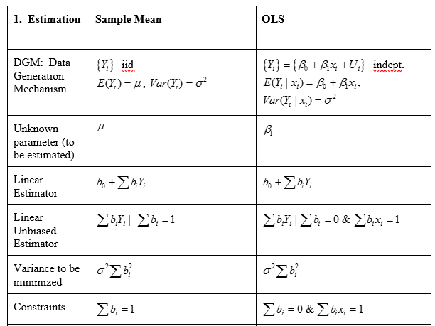
Sample Mean v. OLS: Estimation I

Slide 2
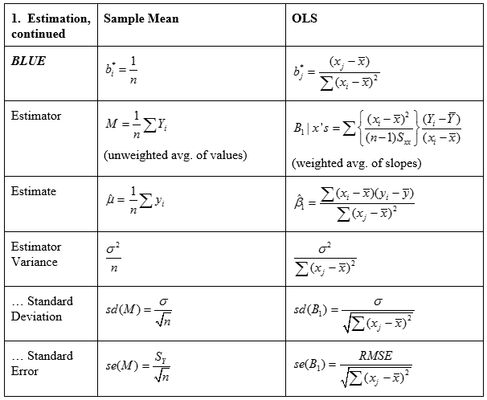
Sample Mean v. OLS: Estimation II

Slide 3
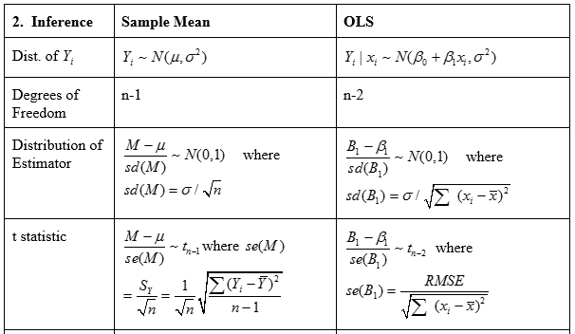
Sample Mean v. OLS: Inference I

Slide 4
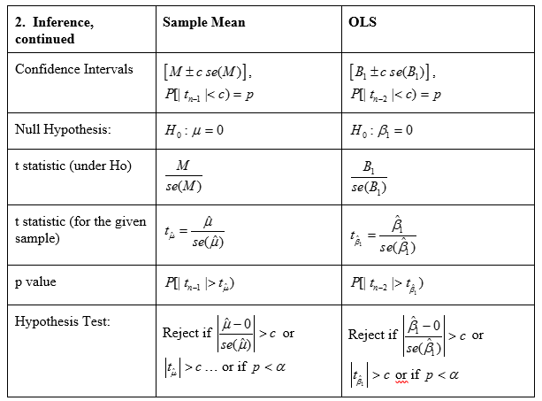
Sample Mean v. OLS: Inference II

